Slide 1
PSHE (Personal, Social and Health Education) The Pupil Charter Open your character journal to page 17

Slide 2
The United Learning Pupil Charter
Our character is developed by everything we do.
The Pupil Charter sets out opportunities which play a significant role in developing character.
These are opportunities where you can demonstrate and practice character traits in real-world situations
Notes:
Page 17 in the character journal

Slide 3
What makes someone successful?
Think-Pair-Share
Think of someone you believe to be successful
What is it that makes them successful to you?
What character traits do you think they have?
Notes:
Page 17 in the character journal Discuss key character traits & link this to charter activities.

Slide 4
How will completing the charter benefit you?
Improved Academic Performance
Notes:
Some students worry that participating in extracurriculars may take away too much time from their schoolwork, thus hurting their grades; however, extracurricular activities can improve your overall outlook on school!
Participating in activities you are passionate about can increase your brain function, and help you concentrate and manage your time better, all of which contribute to higher grades. High endurance sports, for example, will train you to focus and build stamina in the face of intense difficulty. This gives you an advantage when it comes to studying and taking exams.
Lots of studies have been conducted on the relationship between extracurricular activities and academic performance, and they all show that students who participate in them have higher grades, more positive attitudes toward school and higher academic aspirations.

Slide 5
How will completing the charter benefit you?
Explore Interests and Create Broader Perspectives
Notes:
When you participate in different activities, you’ll get the opportunity to explore a range of interests and unlock passions you never knew you had! Plus, diversifying your interests broadens your worldview.
Think about it this way: if you join a philosophy club, you’ll begin to look at the world through the eyes of a budding philosopher.

Slide 6
How will completing the charter benefit you?
Higher Self-esteem
Notes:
When you succeed in the activities you love, your self-confidence will improve. For example, let’s say you’re really good at math and your teacher encourages you to get involved in competitions. You decide to join the school team and start training for the national Math Olympiad. You realize how fun math can be and how talented you actually are during the process, which gives your confidence a massive boost.
Working hard and mastering new skills in a fun, relaxed – and sometimes competitive – setting allows you to be successful without the pressure of getting a good grade. Plus, once your confidence improves, you’ll be more open to taking risks in all aspects of your life

Slide 7
How will completing the charter benefit you?
Social Opportunities
Notes:
Let’s be honest. Making friends can be challenging, but one of the easiest ways is through extracurricular activities! Each extracurricular you engage in provides you with another opportunity to expand your social network, which will also come in handy when you’re looking for a job.
Plus, if you make friends in your extracurricular activities, you’ll be more likely to get more deeply involved. For example, if you make a few friends doing community service at school, you might decide to start a volunteer club together and really impact your community!

Slide 8
How will completing the charter benefit you?
Essential Life Skills
Notes:
On top of all the benefits of extracurricular activities, we already discussed, one of the greatest advantages extracurricular activities give you is “real world” skills.
These skills include (but are not limited to):
Goal setting
Teamwork
Time management
Prioritisation
Problem-solving
Analytical thinking
Leadership
Public speaking

Slide 9
How will completing the charter benefit you?
Notes:
Without previous work experience, one of the only ways hiring managers can assess your ability and work ethic is through your extracurricular activities.
For example, if you were on a debating team, the manager would know that you work well with others, can argue a point professionally and have public speaking experience - all awesome skills to have in the workplace

Slide 10
How will completing the charter benefit you?
Notes:
Universities in the US & UK want to see that you’ve gone above and beyond in your intended area of study and have made a difference and/or excelled in your field.
If you want to major in chemistry, a UK university is more likely to accept you if you’ve joined a chemistry club, taken extra chemistry courses at your local university and volunteered in a lab.
Although that sounds like a lot, extracurricular activities are even more important to US universities. In fact, extracurricular activities and leadership account for about 30% of your application!
US universities don’t limit you to just one passion. If you want to study science and love filmmaking, get involved in scriptwriting, directing, international film competitions, and movie nights that raise money for environmental science. If you’re the president of your school’s science club, you’ll increase your chances of getting into your dream university.
A quick note if you’re considering the US study path
US colleges want to see specific things from your extracurricular activities. Make sure your activities are ticking the following boxes to increase your chances of getting in:
Longevity: You stick with one type of activity rather than joining a new activity every week and quitting one every other week.
Passion: You care about your extracurricular activities and aren’t doing them just to get into a university.
Leadership: You have taken the initiative to become a leader within your activities and community.

Slide 11
The United Learning Pupil Charter
Have you done any of these things so far this year?
Notes:
Page 17 in the character journal

Slide 12
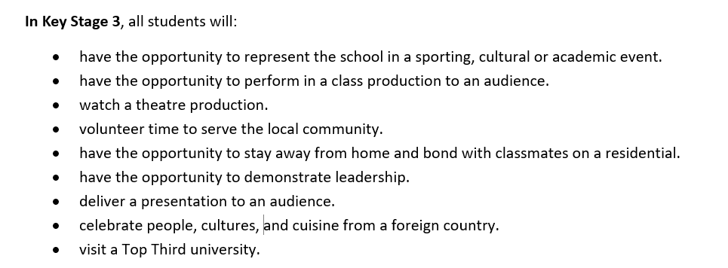
The United Learning Pupil Charter
Have you done any of these things so far this year?
Notes:
Page 17 in the character journal

Slide 13
The United Learning Pupil Charter
Have you done any of these things so far this year?
Notes:
Page 17 in the character journal

Slide 14
The United Learning Pupil Charter
Have you done any of these things so far this year?
Notes:
Page 17 in the character journal

Slide 15
Local Opportunities
Waltham Forest Community Hub: https://www.wfchub.org/
Project Zero WF cic (Waltham Forest Community Interest Company)
Engaging young people In positive activities to promote social inclusion, reduce anti-social / offending behaviour and strengthen community cohesion.
Notes:
Project Zero
Tuesday Youth space – 5pm-7pm
This a chance for young people to engage with activities in the centre. Suitable for walk- ins and anyone aged 8-16 is welcome. Activities include boxing, football, arts and crafts, air hockey, table tennis, pool and snooker.
Wednesday 5pm-7pm
Wednesday Youth Space, 5-7pm, for any young people who have signed up for our clubs.
Good4Girls – in partnership with Focus C.I.C, self esteem support, mental health and wellbeing support, sports and social action plan focus.
FilmMaking– Bring your story board to life and with this film creation workshop
Digi World– All things Gaming and coding, ran from our Games base room.
Our Space, Fridays once a month, 6pm-8:30pm, age 14+
Open Mic Night – rapping, singing, dancing, acting, spoken word and poetry.
Vibez and Essence, Thursday once a month 6pm-8pm, age 11-24
Ladies Night– focusing on different themes, bringing workshops and games together to help educate and unite our young women.
Address: The Outset Centre, 2A Grange Road, E17 8AH
www.projectzerowf.co.uk

Slide 16
Local Opportunities
Project Zero WF cic (Waltham Forest Community Interest Company)
Engaging young people In positive activities to promote social inclusion, reduce anti-social / offending behaviour and strengthen community cohesion.
Notes:
Although you probably participate in activities outside of school, think about the benefits of extracurricular activities and how to maximise your passions. The lessons you’ll learn from participating in meaningful extracurricular activities will help you get a job, apply to universities, and live a meaningful life.
What are you waiting for? Go join a club, start an online class or volunteer today!

Slide 17
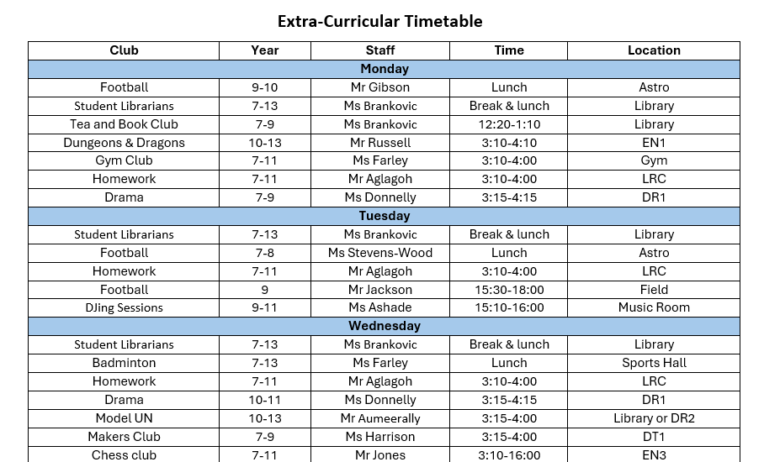
School Opportunities
Notes:
School opportunities they have had so far/currently have (extra-curricular timetable, activities days, trips, cultural gala etc) + time for students to tick what they have already done.

Slide 18
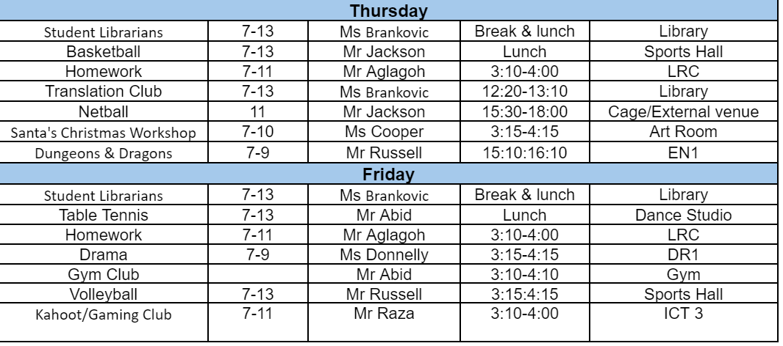
School Opportunities
Notes:
School opportunities they have had so far/currently have (extra-curricular timetable, activities days, trips, cultural gala etc) + time for students to tick what they have already done.

Slide 19
Reflection
What character traits do you want to develop?
How are you going to achieve this?
Notes:
Page 17 in the character journal Discuss key character traits & link this to charter activities.

Slide 20
Next Steps
For more information:
Keep an eye out on google classroom for any opportunities that are posted
Watch out for school and local opportunities on the notice board in the Humanities corridor next to HU3
Ask Ms Vitalis (HU2)
Notes:
Page 17 in the character journal Discuss key character traits & link this to charter activities.

